Slide 1
Recruiting & Retaining Veteran Talent Prepared by: Jim Lindsay Military Employer Relations Partner Southern New Hampshire University
Notes:
THIS SESSION WILL BE RECORDED

Slide 2
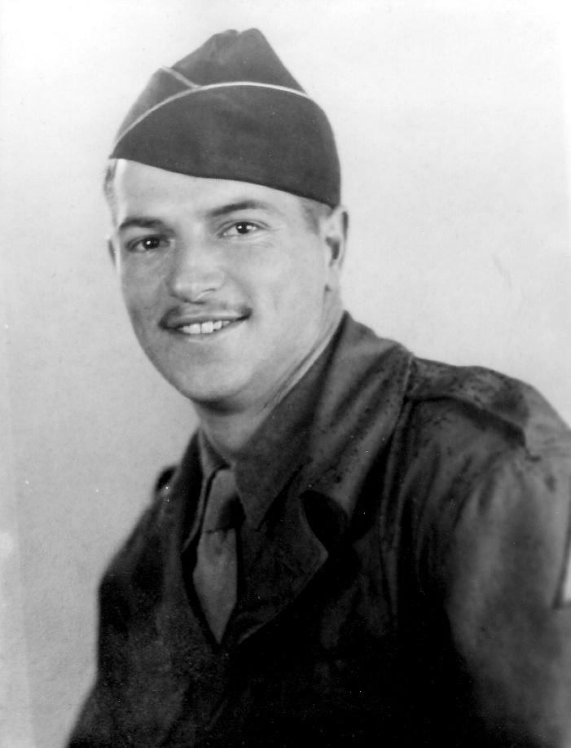
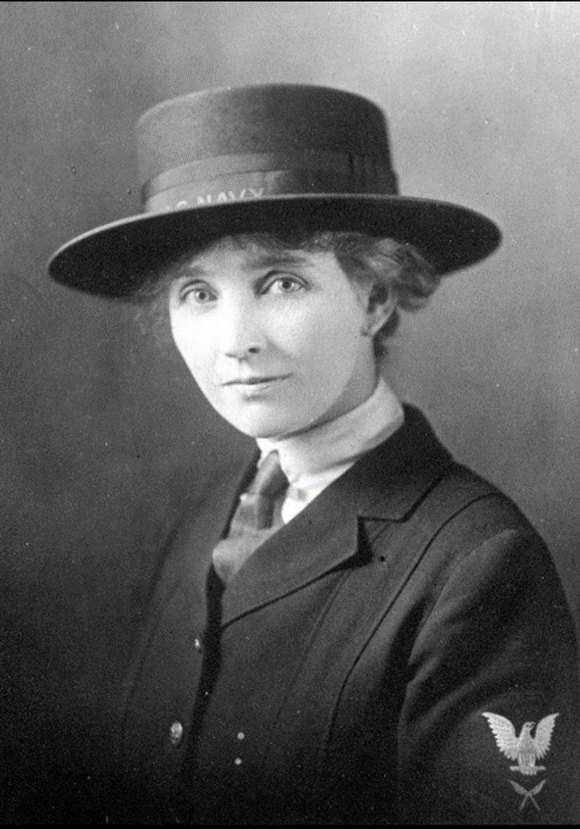
Thank You, Veterans

Slide 3
Veterans Are……
Entrepreneurial
Trustworthy
Adept at Transferring Skills Across Contexts and Tasks
Resilient & Adaptable
Team-Builders
Multi-Cultural & Skilled in Diverse Work Settings
Comfortable and Adept in Discontinuous Environments
Able to Save Your Company Money
REMOTE WORK FOR A
MILITARY-CONNECTED ARMYWORKFORCE
Military.Com, N,D., 10 Reasons Why Employers Want to Hire Veterans. Based on Real Research, Retrieved from: https://www.military.com/hiring-veterans/resources/10-reasons-to-hire-vets.html
Notes:
Entrepreneurial" doesn't mean veterans necessarily want to run off and start their own businesses. It means vets tend to have the same attributes that successful business owners have: self-efficacy, need for achievement, they don't need to be managed, are comfortable with uncertainty and make good decisions under pressure.
2. Integrity is a value instilled in service members from the start. Veterans are not only trustworthy to co-workers and managers; the trust they build between themselves, co-workers and managers also spreads between teams and into the whole organization. The result can be high-performance culture.
3. In the military, troops learn to make do with what they have, wherever they are. Military members are trained to deal with situations when the plan goes awry.
4. Studies have shown veteran resiliency is the result of their military experience, enhancing their abilities to adapt and grow from failures more quickly and completely than those who did not serve in the military
5. Military service specifically enhances individuals in three key ways: Organizing and defining team goals and missions, Defining team member roles and responsibilities, Developing a team's plan for action
6. Veterans have more international experience. Vets speak more languages, more fluently. Veterans have a higher understanding of cultural sensitivity.
7. Research shows that America's all-volunteer military is actually a diverse workforce across a number of important demographics, which include education, ethnicity, culture, values and individual goals and aspirations.
8. Businesses, especially those in information and technology sectors, are constantly changing and evolving, and they're looking for future employees who can work efficiently and effectively in these kinds of environments.

Slide 4
Partner with Local & Federal Groups/Agencies
Military Bases & Local VSOs
Local Employment Centers
Hiring Our Heroes
Easterseals Veteran Staffing Network
SkillBridge
Local & Global Colleges/Universities
REMOTE WORK FOR A
MILITARY-CONNECTED WORKFORCE
McKinney, N., December 5, 2018, Veteran Recruitment; A Multi-Pronged Journey, Retrieved from: https://info.recruitics.com/blog/veteran-recruitment-a-multi-pronged-journey
Notes:
Military bases have Transition Assistance Program (TAP) offices that help active service members transition out of the military to the civilian workforce. Companies have the opportunity to engage/partner with them by providing speakers for their training programs or talk about the company and jobs they have for veterans.
For recruiting locally, employment centers are a great no- to low-cost partner, and most have veteran programs.
Hiring Our Heroes (HOH) connects the military community—service members, military spouses, and veterans—with American businesses to create economic opportunity and a strong and diversified workforce.
The Veteran Staffing Network (VSN) at Easterseals is a national nonprofit staffing agency that connects employers with top-tier military talent and helps veterans and their spouses find meaningful jobs.
The Department of Defense (DOD) manages the DOD SkillBridge Program, an opportunity for active-duty Service Members to gain valuable civilian work experience with employers during their last 180 days of service. DOD SkillBridge connects service members with private and public sector organizations that offer internship opportunities for transitioning Service Members to build their resumes, explore employment interests, develop job skills, and gain valuable work experience that will help them prepare for their adjustment to the workplace.
The Department of Defense Military Spouse Employment Partnership (MSEP) connects military spouses with hundreds of partner employers who have committed to recruit, hire, promote and retain military spouses.
Local & Global Colleges/Universities Western Governors, Liberty, Phoenix, Maryland & of course SNHU

Slide 5
Best Practices for Hiring Veterans
Educate Your Company
Recognize the Value of Military Talent and ROI
Become Familiar with Skills Translation
Hire for Aptitude Not Just Experience
Post on Military Specific Job Boards
Create a Military Specific Hiring Page For Your Company Website
Form A Dedicated Veteran Sourcing/Recruiting Team
REMOTE WORK FOR A
MILITARY-CONNECTED WORKFORCE
VeteranStaffingnetwork.org
Notes:
So many organizations want to hire veterans and support military families but don't know where to start. Like anything else, you don't know what you don't know so businesses interested in hiring veterans must make an investment in education of the executives, front line management and staff.
Leadership is key in the military and a successful business. Organizations that make the most out of the veteran talent pool do so because the company culture respects and understands the value of what a service member can bring to the workplace..
Intangibles such as high performance, loyalty, punctuality, respect for systems and processes and continuous improvement are ingrained in the military persona and an absolute value add for business. Coach staff members to realize the positive characteristics hiring veterans will make to the workplace and encourage support. Leadership teams should evaluate the ROI on hiring individuals with a track record of dedication to excellence and continuity, particularly for positions that commonly experience high turnover. The investment extended to hire a veteran will provide a return in multiple ways.
4. Few skills sets and "jobs" exist in the civilian workforce that do not have a direct military counterpart. The challenge most employers face is understanding the military professions that relate to the organization's needs.
Research military skills translators, and there are many of them available online. Government resources include www.OnetOnline.org from the US Dept. of Labor and Civilian-to-Military Occupation Translator at CareerOneStop’s Business Center.
5. Organizations should evaluate candidates on skills vs. not just number of years of experience. Employers frequently do not realize the experience gained in the military is fast paced and detailed. Individuals with 6 months of exposure in a particular job function in the service may have more "hands on" time with a job task than his or her civilian counterpart with over two years in the role.
6. Recruit Military, Military Friendly.com Bradly-Morris
7. This can help show the veteran or military spouse that the company recognizes the importance of recruiting from the military population
8. Made Up Of not just Civilians but Veterans Who Have Made A Successful Transition To Civilian Employment

Slide 6
Retention
Hire Correctly
Pair a Veteran Employee Survey with a Mentoring Program
Create/Utilize a Veteran Employee Resource Group (VERG)
Develop a Veteran Recognition Program
REMOTE WORK FOR A
MILITARY-CONNECTED WORKFORCE
https://www.veteranstaffingnetwork.org/post/4-ways-to-retain-your-veteran-talent
Notes:
match the job requirements. With military candidates, the matching of experience vs. needed skills for the job can sometimes be less clear than their civilian counterparts. Before extending the offer to a veteran candidate, ensure both you and the veteran understand how his/her experience and skills match the position. Aligning in the way increases the chances of your new hire staying
2. Creating a veteran mentor program or “Buddy” program. match a veteran new hire with an existing veteran on your staff. This match may only last a few weeks to a few months and the idea is to give the new hire a person on the staff to assist in acclimating to the organization. A few regularly scheduled calls, maybe a welcome lunch, is a great way for the new hire to feel welcomed once onboard.
3. Employee resource groups have been effectively used in corporate America for years and having one focused on veteran and military family concerns is a great idea for keeping your military workforce. Having a committed group of veterans working to make the work environment better for other veterans will go a long way to retaining these people.
4. It is no secret that regular recognition and praise of employees increases productivity, engagement and a likelihood of retention. A program focused on your veteran population will do the exact same thing with this specialized group. Include a write up of the veteran worker of the quarter in your monthly newsletter to employees. Committing to keeping your veteran talent is as important as committing to hire them in the first place. Simply by taking small and inexpensive steps you can help build an inclusive culture where your veteran team members feel valued, increasing the chances of them staying with your team.

Slide 7
REFERENCES
Alwine, R., February 18, 2015, 10 Reasons to Hire a Military Spouse
Ceo-review: Retrieved from; https://www.ceo-review.com/the-key-to-staff-retention-and-recruitment-understanding-employees-post-pandemic-work-perks-must-have/
Hiringourheroes: Retrieved from: https://encrypted-tbn0.gstatic.com/images?q=tbn:ANd9GcR-4jonYmOj6hsdkogd30mubnS_1F9ay0Ph1Q&usqp=CAU
IN.GOV: https://www.google.com/imgres?imgurl=https%3A%2F%2Fwww.in.gov%2Fdwd%2Fimages%2FMilitary-Handshake-Composite.png&tbnid=I_BMgD9kCzRaIM&vet=12ahUKEwjV58OZiqGCAxXyMWIAHRkdCQQQMygUegUIARCYAQ..i&imgrefurl=https%3A%2F%2Fwww.in.gov%2Fdwd%2Fbusiness-services%2Fhire-a-veteran%2F&docid=ciTd_GDAQoOMmM&w=600&h=369&q=veteran%20employment&hl=en&ved=2ahUKEwjV58OZiqGCAxXyMWIAHRkdCQQQMygUegUIARCYAQ
McKinney, N., December 5, 2018, Veteran Recruitment; A Multi-Pronged Journey, Retrieved from: https://info.recruitics.com/blog/veteran-recruitment-a-multi-pronged-journey
Militarybases.com: https://militarybases.com/uncategorized/military-veterans-careers/
Military.Com, N,D., 10 Reasons Why Employers Want to Hire Veterans. Based on Real Research, Retrieved from: https://www.military.com/hiring-veterans/resources/10-reasons-to-hire-vets.html
People Scout, N.D., Retrieved from: Peoplescout.com
4 Ways to Retain Your Veteran Talent https://www.veteranstaffingnetwork.org/post/4-ways-to-retain-your-veteran-talent
WE HOPE TO SEE YOU SOON!

Slide 8
THANK YOU

